Slide 1
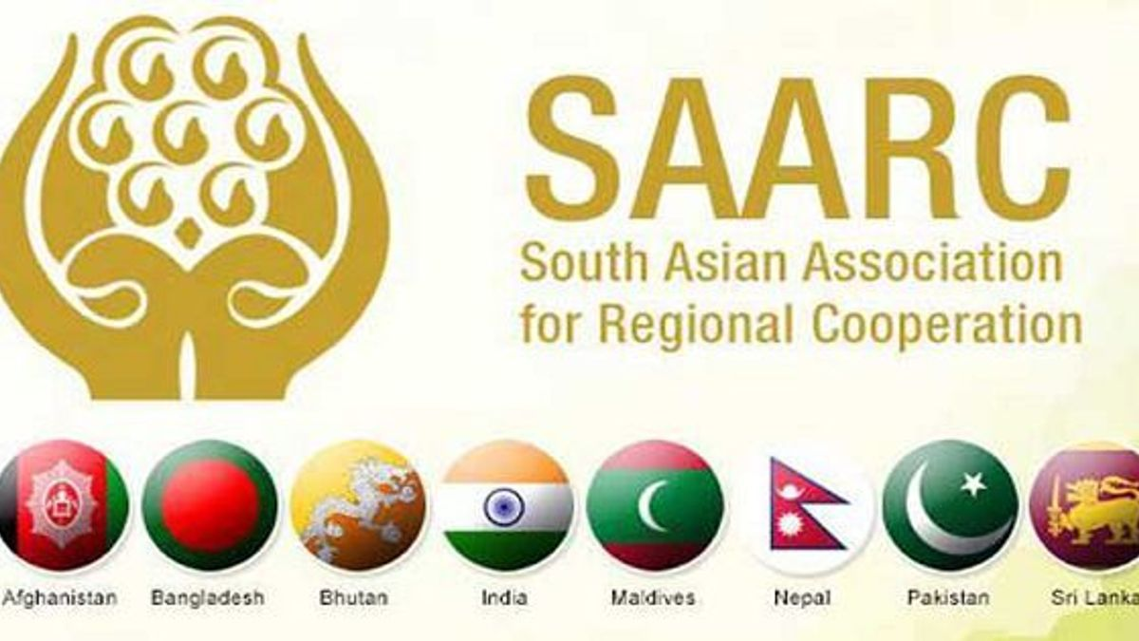
SAARC (South Asian Association for Regional Cooperation)
Dr. Sahidujjaman Khan
Assistant Professor
Department of History
Tarakeswar Degree College

Slide 2
Introduction
SAARC (South Asian Association for Regional Cooperation) is an intergovernmental organization established in 1985.
Its primary objective is to promote regional cooperation among South Asian countries for peace, stability, and socio-economic development.

Slide 3
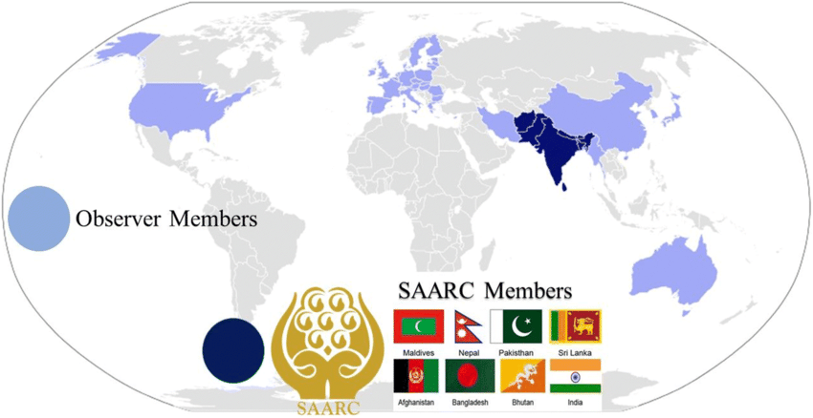
Member Countries
SAARC consists of eight member countries: Afghanistan, Bangladesh, Bhutan, India, Maldives, Nepal, Pakistan, and Sri Lanka.
Each member country has equal voting rights within the organization.

Slide 4
Objectives of SAARC
SAARC aims to enhance cooperation in various sectors, including agriculture, trade, investment, technology, culture, and people-to-people exchanges.
Its key objectives include poverty alleviation, promoting economic growth, and improving the quality of life in the region.

Slide 5
Institutional Structure
SAARC has a three-tier structure: Summit, Council of Ministers, and Secretariat.
The Summit, consisting of heads of state or government, is the highest decision-making body.
The Council of Ministers, comprising foreign ministers, oversees the implementation of policies and decisions.
The Secretariat, based in Kathmandu, serves as the administrative and coordinating body of SAARC.

Slide 6
Areas of Cooperation
SAARC focuses on various areas of cooperation, such as agriculture, health, education, environment, tourism, and energy.
Special emphasis is given to regional connectivity, trade facilitation, and infrastructure development to boost economic integration.

Slide 7
Achievements and Initiatives
SAARC has made significant achievements, including the establishment of the South Asian Free Trade Area (SAFTA) to promote intra-regional trade.
It has launched initiatives like the SAARC Development Fund, SAARC Cultural Centre, and South Asian University to enhance cooperation in specific fields.

Slide 8
Challenges and Limitations
SAARC faces challenges such as political differences, historical conflicts, and varying levels of economic development among member countries.
Bilateral tensions and non-cooperation have at times hindered the full realization of SAARC's potential.

Slide 9
Future Prospects
Despite challenges, SAARC holds immense potential for regional integration and cooperation.
Efforts are being made to revive and strengthen the organization, including through the initiation of informal meetings and dialogue processes.

Slide 10
Regional Initiatives
SAARC has collaborated with other regional organizations like ASEAN, BIMSTEC, and the Gulf Cooperation Council to promote regional connectivity and cooperation.
These initiatives aim to enhance trade, investment, and people-to-people exchanges between South Asia and other regions.

Slide 11
Conclusion
SAARC plays a vital role in fostering regional cooperation and addressing shared challenges in South Asia.
Continued efforts to enhance collaboration and overcome existing barriers can contribute to greater peace, stability, and development in the region.

